Slide 1


SNHU CS - 470 Project Two Conference Presentation: Cloud Development
February 24, 2024
Scott Dixon
Computer Science student at SNHU
Notes:
Upbeat Music

Slide 2

Overview
Hello!, I’m Scott Dixon
A Computer Science student in the final courses of the program.
The purpose of this talk is to articulate the intricacies of cloud development to both technical and non-technical audiences.
Notes:
Good afternoon and welcome everyone to the CS-470 conference presentation in Cloud Development. My name is Scott, I am a fourth-year Computer Science major, and as many of you are, just about to receive my degree. Today, I'm excited to present this talk about the many facets of cloud development. Whether you're a seasoned tech enthusiast or someone just beginning in the world of technology, I'll do my best to make this presentation informative and engaging for all.
The purpose of today's presentation is twofold. First off, I’d like to introduce myself and give a bit of background on who I am and why I’m interested in cloud development. Secondly, I would like to talk about the many aspects of cloud development and explain any complexities in a way that both technical and non-technical audiences can understand.
So, let’s lock the hatch and Blast Off to explore the fascinating world of cloud development together!

Slide 3

Development Concepts:
Serverless versus local storage
Advantages of a serverless API.
Differences between MongoDB and DynamoDB
Cloud-based development
Security in a cloud-based application
Notes:
In this presentation, we'll explore various topics like:
Serverless versus local storage
Advantages of a serverless API.
Differences between MongoDB and DynamoDB
Cloud-based development – creation of a cloud application.
Security in a cloud-based application

Slide 4

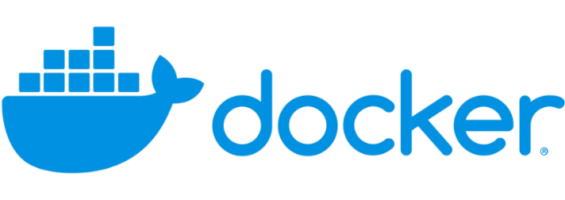
Containerization
Containerization:
What is a container?
How does it work?
What are the benefits of containers?
Key components of containers.
Notes:
Migrating full-stack applications to the cloud offers numerous benefits, including scalability and cost-efficiency. By understanding the different migration models and best practices, a business can navigate the cloud migration task with ease, unlocking the full potential of cloud computing for their applications. To explain what is involved in taking an application to the cloud I will explore models of containerization and orchestration.
First, I would like to speak about Containerization, describing what a container is – how containers work – the benefits of using containers, and the key aspects of containerization.
What is a container? A container simplifies the process of packaging and deploying applications by encapsulating each component and its dependencies into a lightweight container. Think of containers as portable storage baskets that hold everything your application needs to run, from code to libraries and configurations.

Slide 5

Orchestration
What is the value of using Docker Compose?
Notes:
A secondary aspect of containerization is orchestration - Think of orchestration as the superhero movers for your applications! Just like movers help to handle all the heavy lifting and transportation during a move, tools such as Docker Compose manage the nitty-gritty details of deploying, scaling, and taking care of your containers.
The Orchestration tools like Docker Compose automate the deployment, scaling, and management of containers, making sure they're in the right place at the right time and running without a hitch across your entire infrastructure. So, you can sit back, relax, and let these superhero movers take care of business!

Slide 6

The Serverless Cloud
API & Lambda
Describe the advantages of using a serverless API.
Explain Lambda API Logic.
What scripts are produced in order to make this happen?
Summarize the steps needed to integrate the frontend with the backend.
Notes:
The serverless cloud:
Using a serverless API offers advantages such as scalability, cost-effectiveness, and simplified infrastructure management
Serverless platforms automatically scale resources based on demand, so you don't need to worry about provisioning or managing servers. This ensures your API can handle sudden spikes in traffic without any downtime.
Also, an advantage of serverless, you only pay for the resources you use, typically measured in function calls and execution time. This can result in significant cost savings compared to traditional server-based architectures where you pay for idle resources.
Serverless platforms hide the complexities of the underlying infrastructure, allowing developers to focus solely on writing code. This reduces the operational overhead associated with managing server and networking roles.
The scripts produced to make this happen are essentially the code for the Lambda functions. These scripts contain the logic for handling API requests and generating responses. They can include any necessary dependencies, such as SDKs for interacting with AWS services or third-party libraries for specific functionality.

Slide 7

Data Model for The Serverless Cloud
What are the data-model differences between MongoDB and DynamoDB?
What queries did you perform?
What scripts are produced in order to make this happen?
Notes:
MongoDB utilizes a flexible document-based data model, where data is stored in JSON-like documents. Documents are grouped into collections, and each document encompasses its structure and schema. MongoDB supports complex queries and indexes.
DynamoDB utilizes a key-value and document-based data model. Data is organized into tables, where each item can have a different structure. DynamoDB requires specifying a primary key for each item, which can be a simple partition key or a composite partition and sort key.
Queries in MongoDB performed operations such as find, update, and delete while in DynamoDB which supports key-based operations, queries for retrieving, updating, and deleting items based on their primary keys were used.
Scripts that were written included operations to connect to the MongoDB server and perform CRUD operations. (Create, Read, Update, Delete) while DynamoDB included operations to authenticate with Amazon Web Service, interact with DynamoDB tables, execute queries, and handle responses.

Slide 8
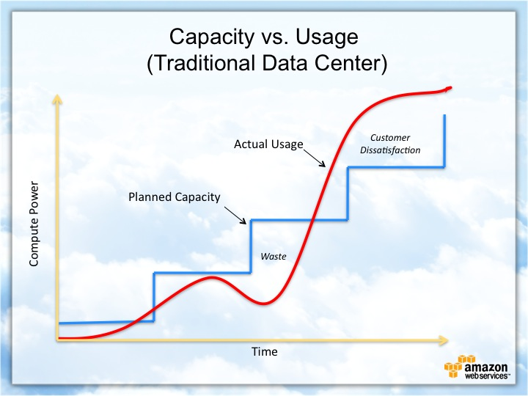
Cloud-Based Development Principles
Elasticity
Pay-for-use model
Notes:
Next, I will describe Elasticity and the Pay-as-you-go concept in cloud-based development.
Elasticity in cloud computing refers to the ability of a system to dynamically shift computing resources based on workload. Essentially, it's about scaling resources up or down automatically in response to changes in demand.
The pay-for-use model is a billing model commonly employed by cloud service providers. It requires customers to pay only for the cloud resources and services they use, rather than making upfront investments in infrastructure.
This seems to be an efficient and cost-effective manner to host an application in a cloud – based server.

Slide 9

Securing Your Cloud App
Access
How can you prevent unauthorized access?
API Security
Policies
Explain the relationship between roles and policies.
What custom policies were created?
How can you secure the connection between Lambda and Gateway?
Lambda and the database
S3 Bucket
Notes:
Preventing unauthorized access to cloud information in AWS involves a strategy that includes multiple layers of protection. This can be accomplished by using Identity Access Management to control access to AWS services and resources. Create IAM users, groups, and roles with the principle of least privilege, granting only the permissions necessary for users to perform their tasks.
Enable Multi-factor Authentication (MFA) for added security.
The difference between IAM roles and policies in AWS is that a role is a type of IAM identity that can be authenticated and authorized to utilize an AWS resource, whereas a policy defines the permissions of the IAM identity.
To secure the connection between Lambda and API Gateway, Lambda and the database, and Lambda and an S3 bucket, it is important to implement various security measures:
Use API Gateway resource policies to control access at the API level and restrict access based on IP address, VPC endpoints, or Amazon Resource Names (ARNs).

Slide 10

Conclusion
Cloud Security
Best Practices
Continuous Learning
Thank you for your time.
Notes:
Thank you for attending the CS-470 talk about Cloud Development. I would like to leave you with three takeaways from our conference…
Cloud Security: I would like to highlight the importance of cloud security in today's digital landscape. With the increasing use of cloud-based services, organizations need to prioritize security measures to protect their data, applications, and infrastructure from cyber threats and breaches.
Best Practices: I would like to mention the importance of best practices and strategies for securing cloud environments, including implementing strong identity and access management controls, encrypting sensitive data, monitoring and auditing cloud resources, and adopting a proactive approach to threat detection.
Continuous Learning: I would also like to emphasize the need for continuous learning and adaptation in the field of cloud security. As technology evolves and new threats emerge, security professionals need to stay updated on the latest trends, tools, and techniques to effectively safeguard cloud environments and mitigate security risks.

